Slide 1
Predicting Election Results using Campaign Finances
By George Daher

Slide 2
Background
A significant part of the democratic election process in the US is fundraising
The Federal Election Committee (FEC) collects financial information about all federal election races.
Mission: “To protect the integrity of the federal campaign finance process by providing transparency and fairly enforcing and administering federal campaign finance laws.”
My goal was to understand the relationship between campaign finance data and actual election results

Slide 3
Prior Research
Conventional Wisdom – Better funded candidate wins
Exhaustive Prior Research on Topic
Majority of time better funded candidate wins - Koerth, 2018
Addressing Confounding Variables minimized this effect – Levitt, 1994
Little investigation into sources of funding – Alexander, 2015
Caveat of negative relationship with funding for incumbents – Ansolabehere & Gerber, 1994

Slide 4
Research Question
General Question: Do characteristics of campaign have a relationship with election outcome in federal elections for the House of Representatives over 3 election cycles (2014, 2016, and 2018)?
Outcome: Votes Received, Proportion of Votes Received, Binary Win/Loss
Project Question: Can we use a logistic model to predict election outcome (win or loss)?
H₀ : The derived logistic model is a good fit for the data
H_{A} : The derived logistic model is not a good fit for the data
Model could be useful, although a causative effect is not measured

Slide 5
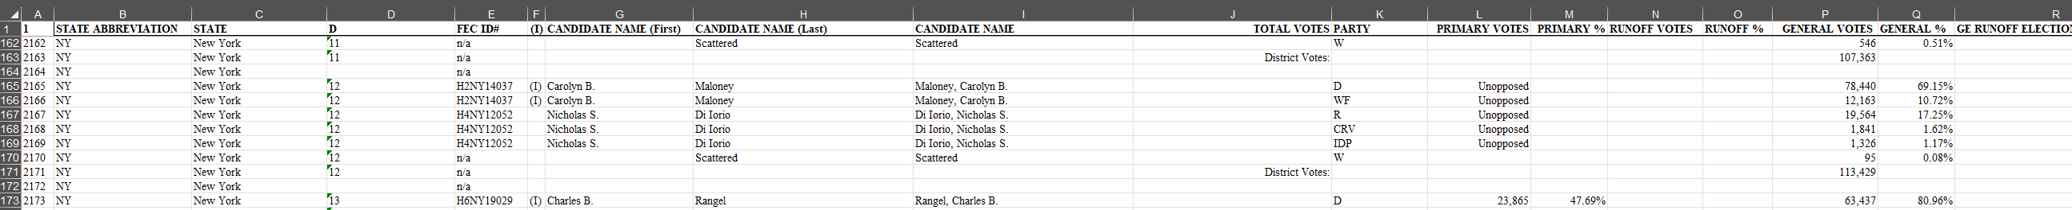
Data Source
Data from FEC website – collected and reported themselves
Two datasets, finance information and election results for each of the 3 election cycles (so 6 files total)
Analysis required merging datasets
Extensive data cleaning was also required due to problematic formatting

Slide 6
Data Cleaning
Required iterating through the entire data multiple times by election ID and district
Used R out of ease of implementation – specific methods coded
Done for each election cycle then all combined
Final dataset had 2468 observations

Slide 7
Data Dictionary
Column name | Field name | Position | Null | Data type | Description | Example data
CAND_ID | Candidate identification | 1 | N | VARCHAR2 (9) |  | H8VA01233
CAND_NAME | Candidate name | 2 | Y | VARCHAR2(200) |  | Martha Washington
CAND_ICI | Incumbent challenger status | 3 | Y | VARCHAR2(1) |  | I
PTY_CD | Party code | 4 | Y | VARCHAR2(1) |  | NON
CAND_PTY_AFFILIATION | Party affiliation | 5 | Y | VARCHAR2(3) |  | NON
TTL_RECEIPTS | Total receipts | 6 | Y | Number(14,2) |  | 345,456.34
TRANS_FROM_AUTH | Transfers from authorized committees | 7 | Y | Number(14,2) |  | 4000.00
TTL_DISB | Total disbursements | 8 | Y | Number(14,2) |  | 175645.21
TRANS_TO_AUTH | Transfers to authorized committees | 9 | Y | Number(14,2) |  | 0.00
COH_BOP | Beginning cash | 10 | Y | Number(14,2) |  | 845901.23
COH_COP | Ending cash | 11 | Y | Number(14,2) |  | 915671.43
CAND_CONTRIB | Contributions from candidate | 12 | Y | Number(14,2) |  | 500.00
CAND_LOANS | Loans from candidate | 13 | Y | Number(14,2) |  | 250000.00
OTHER_LOANS | Other loans | 14 | Y | Number(14,2) |  | 0.00
CAND_LOAN_REPAY | Candidate loan repayments | 15 | Y | Number(14,2) |  | 100000.00
OTHER_LOAN_REPAY | Other loan repayments | 16 | Y | Number(14,2) |  | 0.00
DEBTS_OWED_BY | Debts owed by | 17 | Y | Number(14,2) |  | 250.00
TTL_INDIV_CONTRIB | Total individual contributions | 18 | Y | Number(14,2) |  | 450000.00
CAND_OFFICE_ST | Candidate state | 19 | Y | VARCHAR2(2 |  | VA
CAND_OFFICE_DISTRICT | Candidate district | 20 | Y | VARCHAR2(2) |  | 01
SPEC_ELECTION | Special election status | 21 | Y | VARCHAR2(1) | Election result data included in 1996-2006 files only. | W
PRIM_ELECTION | Primary election status | 22 | Y | VARCHAR2(1) | Election result data included in 1996-2006 files only. | L
RUN_ELECTION | Runoff election status | 23 | Y | VARCHAR2(1) | Election result data included in 1996-2006 files only. | W
GEN_ELECTION | General election status | 24 | Y | VARCHAR2(1) | Election result data included in 1996-2006 files only. | L
GEN_ELECTION_PRECENT | General election percentage | 25 | Y | Number(7,4) | Election result data included in 1996-2006 files only. | 63.2
OTHER_POL_CMTE_CONTRIB | Contributions from other political committees | 26 | Y | Number(14,2) |  | 200000.00
POL_PTY_CONTRIB | Contributions from party committees | 27 | Y | Number(14,2) |  | 200000.00
CVG_END_DT | Coverage end date | 28 | Y | DATE(MM/DD/YYYY) | Through date | 10/19/2018
INDIV_REFUNDS | Refunds to individuals | 29 | Y | Number(14,2) |  | 4000.00
CMTE_REFUNDS | Refunds to committees | 30 | Y | Number(14,2) |  | 100

Slide 8
EDA (1)
Many of the financial variables have seemingly no relationship or a moderately weak relationship with election outcome
We use proportion of vote to visualize the relationship more clearly

Slide 9
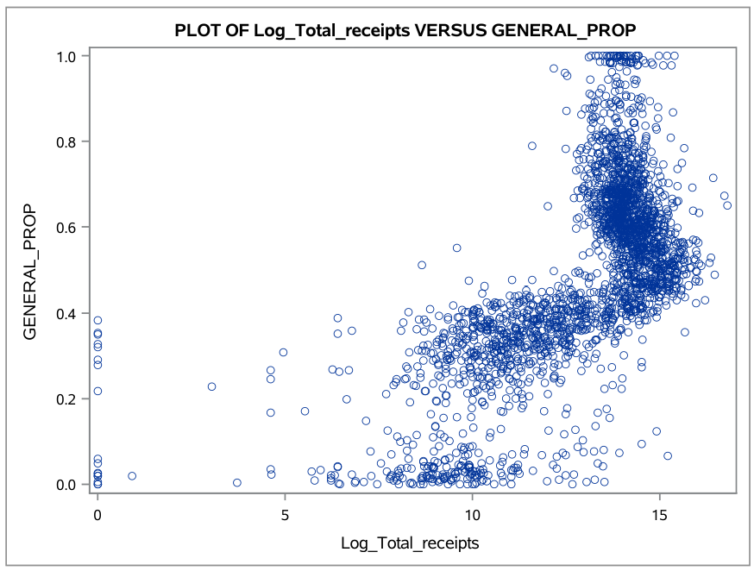
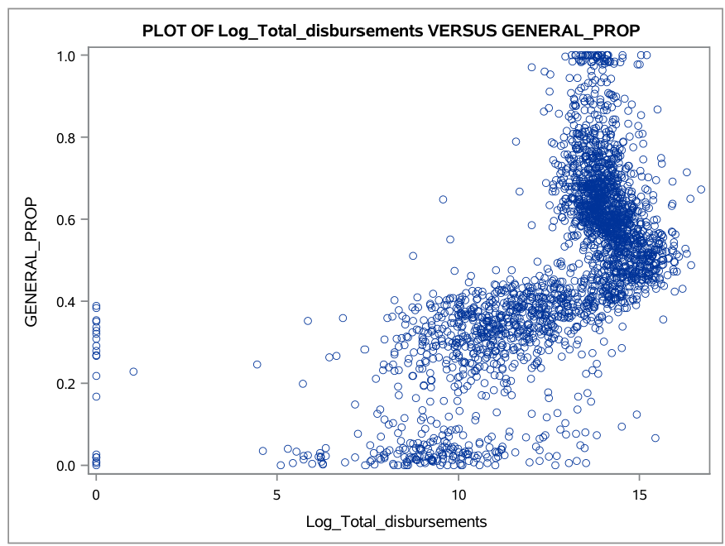
EDA (2)
This is similar, but slightly more apparent if we log-transform the financial variables

Slide 10
EDA (3)
Additionally, we see that the financial variables are not too strongly correlated, from the correlation table (only part of table shown)

Slide 11
Analysis
Due to the nature of logistic regression, using the transformed or untransformed variables has little effect on the model
Models ran with either yielded similar results
We consider four models: (entry/exist significance 0.01)
Full Model with all Variables
Backwards Elimination model
Stepwise Selected model
Stepwise Selected model with 2-way interaction effects
We can compare these models to select our preferred result

Slide 12
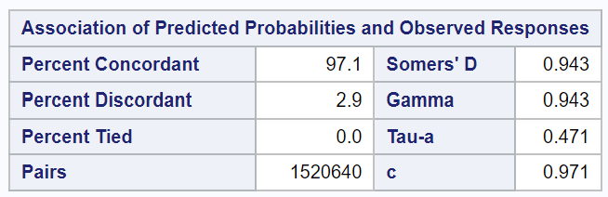
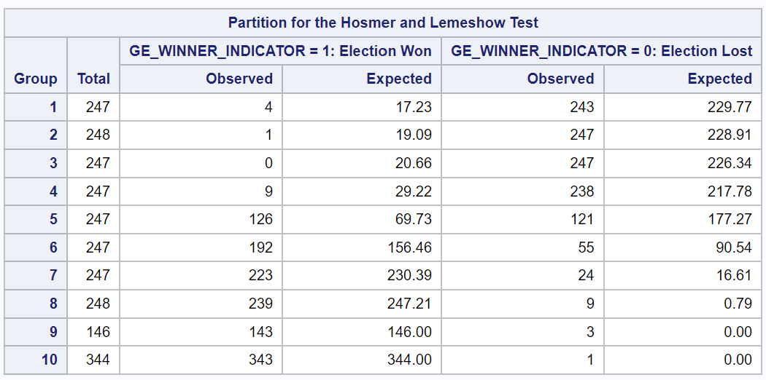
Comparing Models
All models converged
The models are similarly accurate and giving a higher probability of occurrence to the actual result (concordance)
<= Full Model (similar results for all)
They are weaker at predicting individual events, but predict behavior over multiple data points fairly well

Slide 13
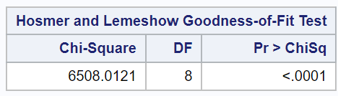
Comparing Models (cont.)
Model performance is similar across the three
Need to check overall model fit
<= Full Model (similar results for all)
None of these models pass the Hosmer and Lemeshow goodness of fit test
With very high critical values and very low p-values, the null hypothesis of the model fitting is rejected in all cases

Slide 14
Conclusion
Based on campaign finance data alone, we cannot model whether a candidate (among house of representative candidates from 2014, 2016 and 2018) they won or lost an election
Although the logistic model was able to separate the data effectively (high concordance and decent cross validation), the model was not a good fit, meaning it does not explain a significant amount of variance in the data
Separation accurate, but magnitude of variable impacts is not
Results do not support or disprove any claims from existing research

Slide 15
Further Research
Incorporate the paired structure of the data
Incorporating paired structure while maintain predictive power could be difficult – Converting to Proportions did not Work
Expand the number of election years considered
Consider senate elections as well
Instead of looking at summary statistics provided by the FEC, collect summary statistics using raw data also provided
Consider potentially confounding variables of demographics and information about the districts

Slide 16
References
Alexander, B. (2005). Good Money and Bad Money: Do Funding Sources Affect Electoral Outcomes? Political Research Quarterly, 58(2), 353–358. https://doi.org/10.2307/3595635
Ansolabehere, S., & Gerber, A. (1994). The Mismeasure of Campaign Spending: Evidence from the 1990 U.S. House Elections. The Journal of Politics, 56(4), 1106–1118. https://doi.org/10.2307/2132077
Briffault, R. (1999). Public Funding and Democratic Elections. University of Pennsylvania Law Review, 148(2), 563–590. https://doi.org/10.2307/3312798
Gerber, A. (1998). Estimating the Effect of Campaign Spending on Senate Election Outcomes Using Instrumental Variables. The American Political Science Review, 92(2), 401–411. https://doi.org/10.2307/2585672
Jacobson, G. C. (1990). The Effects of Campaign Spending in House Elections: New Evidence for Old Arguments. American Journal of Political Science, 34(2), 334–362. https://doi.org/10.2307/2111450
Klumpp, T., Mialon, H. M., & Williams, M. A. (2015). Leveling the Playing Field? The Role of Public Campaign Funding in Elections. American Law and Economics Review, 17(2), 361–408. http://www.jstor.org/stable/24735755
Koerth, M. (2018, September 10). How Money affects elections. FiveThirtyEight. https://fivethirtyeight.com/features/money-and-elections-a- complicated-love-story/
Levitt, S. D. (1994). Using Repeat Challengers to Estimate the Effect of Campaign Spending on Election Outcomes in the U.S. House. Journal of Political Economy, 102(4), 777–798. http://www.jstor.org/stable/2138764
Schuster, S. S. (2020). Does campaign spending affect election outcomes? New evidence from transaction-level disbursement data. The Journal of Politics, 708646, 000–000. https://doi.org/10.1086/708646
Stratmann, T. (2006). Contribution Limits and the Effectiveness of Campaign Spending. Public Choice, 129(3/4), 461–474. http://www.jstor.org/stable/25487608

